Slide 1
Discussion 2
HOFs, MT1 Prep
Jason Zhou | Section 136
CS61A Spring 2019

Slide 2
Announcements
Today: HW02 Due, Lab02 Due
Saturday 12-3PM: HKN Review HP
Sunday 2-3PM: CSM Review GBP100
Monday: Midterm 1
MT1 Study Guide
Cheat Sheet
Seating Assignments
55 mins.

Slide 3
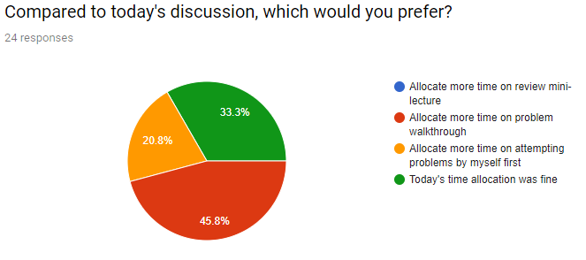

Slide 4
Agenda
Currying/Lambda Functions
Worksheet
Past Exam Practice

Slide 5
Currying & Lambdas
converting a multi-argument function into a single-argument, higher-order function
normal_add(a, b) vs. curry_add(a)(b)
normal_add(a, b)
Takes in 2 arguments
Returns 1 value
curry_add(a)
Takes in 1 argument
Returns a function, h(b)
h(b) takes in 1 argument
Returns a value
Can curry multiple times
Question: Write a 1-line function h with:
Input f, where f is a two-argument function
Outputs the curried form of f
h = lambda f: lambda x: lambda: y: f(x, y)

Slide 6
Worksheet
Practice

Slide 7
Midterm
Practice

Slide 8
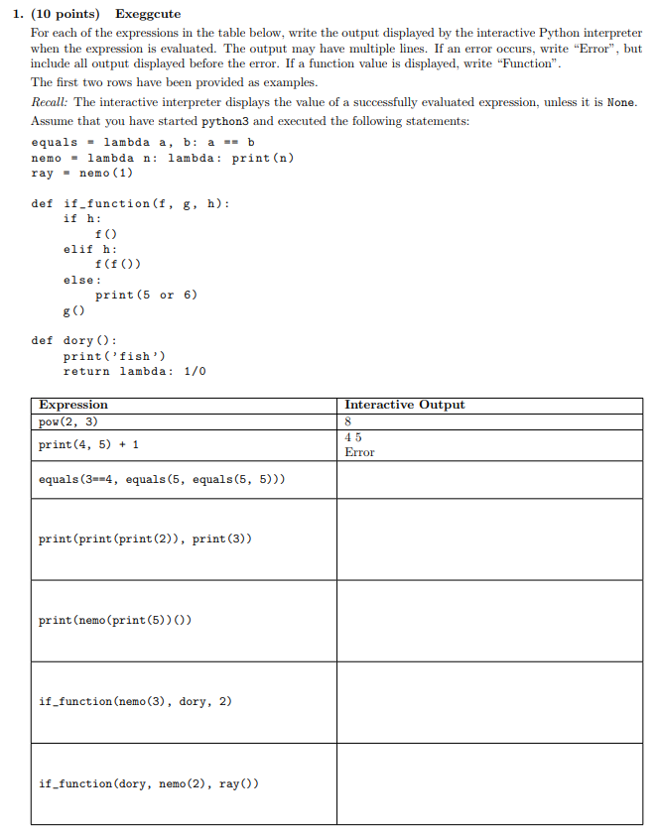

Slide 9
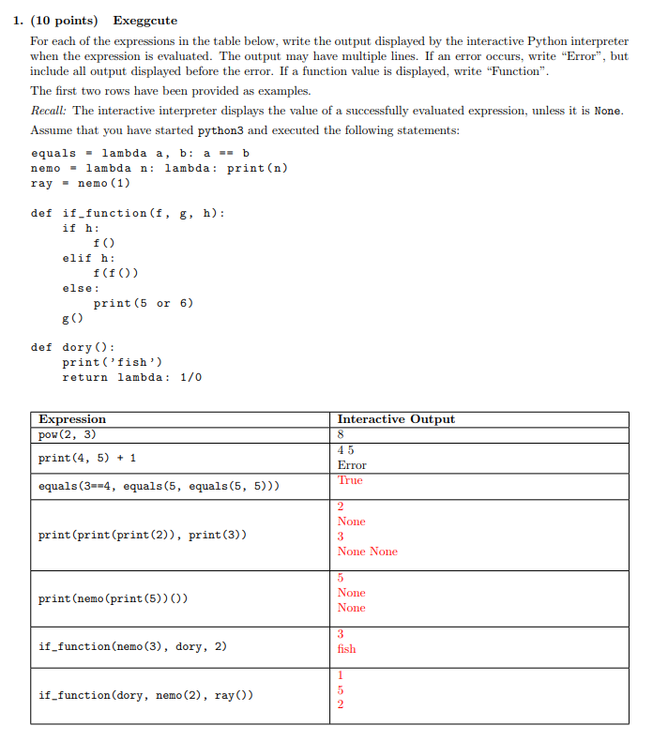

Slide 10
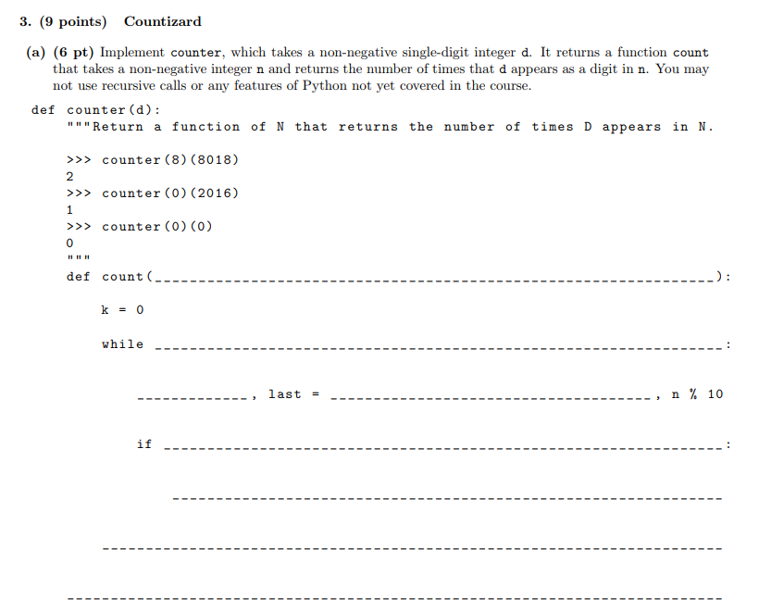

Slide 11
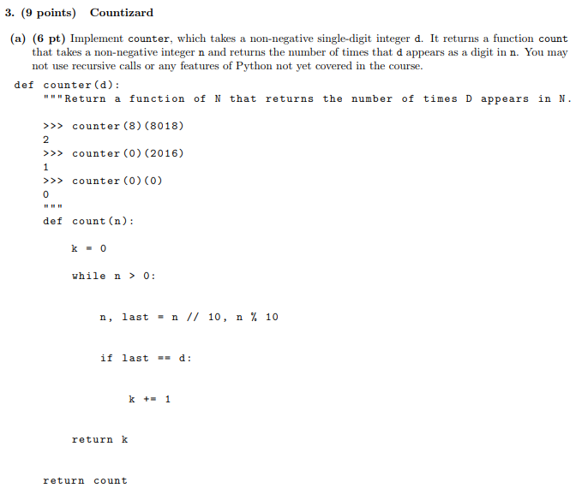

Slide 12
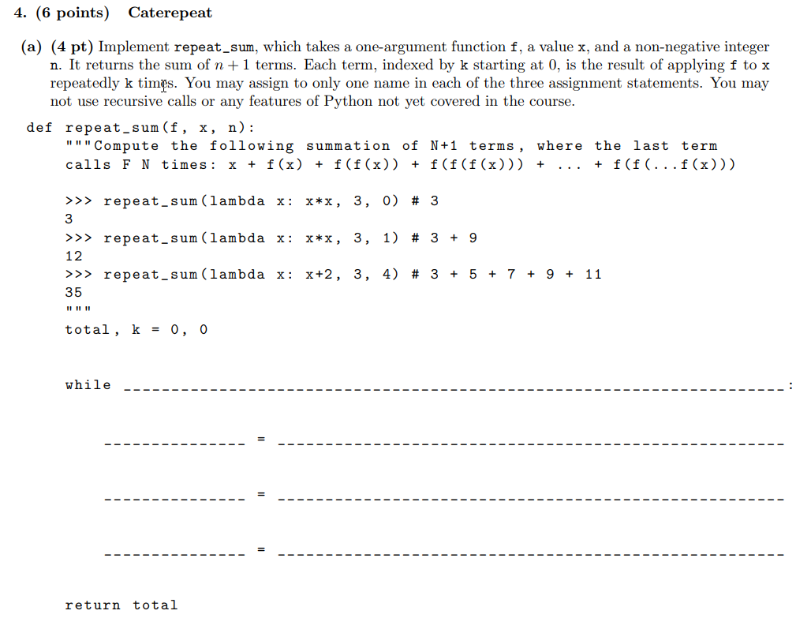

Slide 13
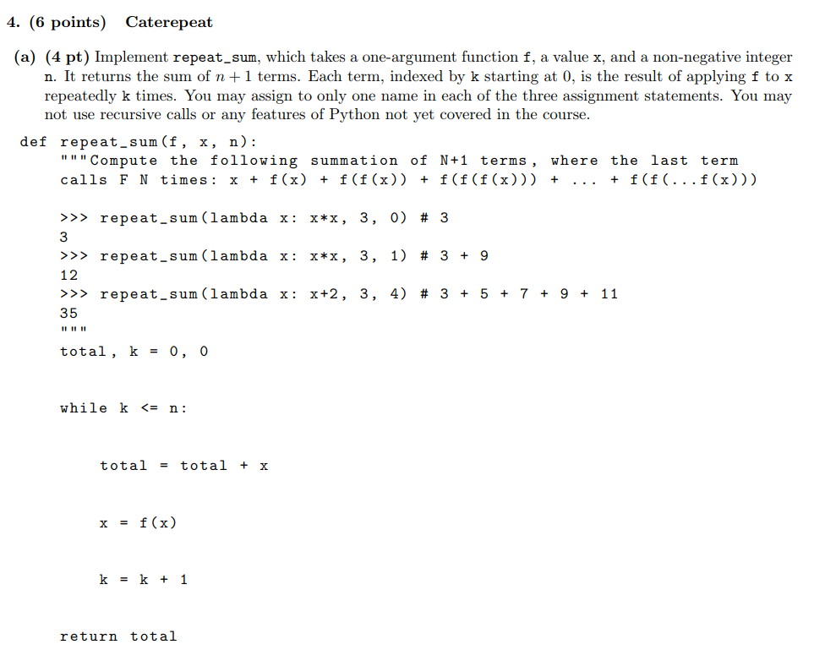

Slide 14
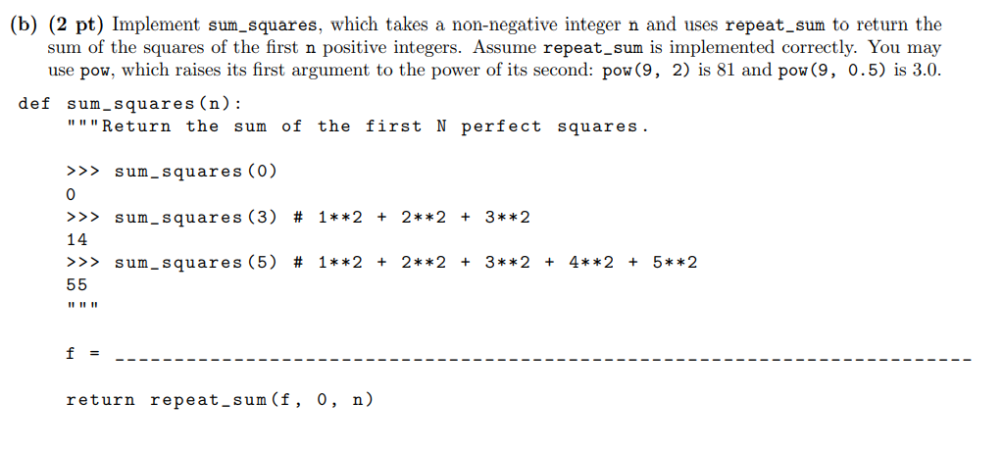

Slide 15
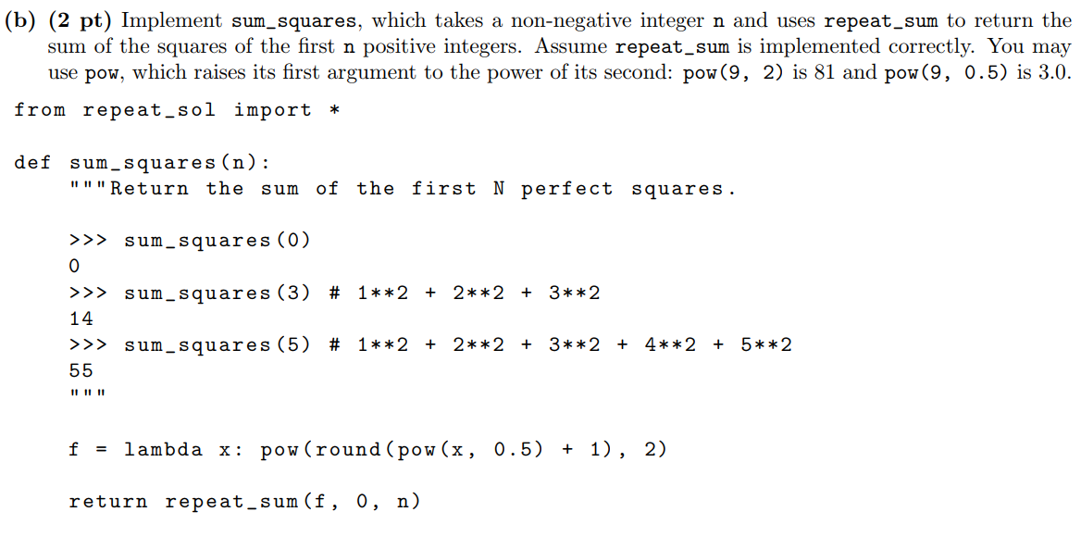

Slide 16
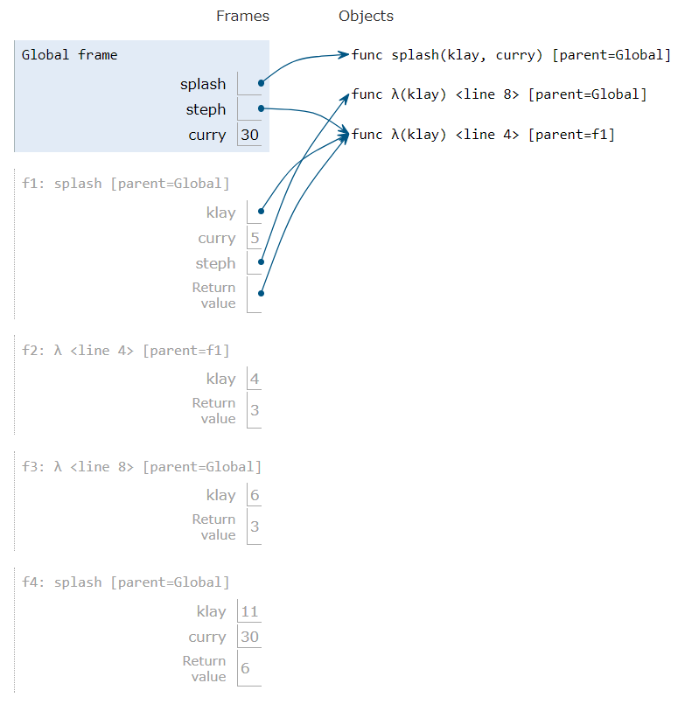
Extra ED:
def splash(klay, curry):
while curry == 3:
steph = klay
klay = lambda klay: steph(curry + 1)
curry = curry + 2
return klay
return curry // 5
steph = lambda klay: splash(11, curry)-3
steph, curry = splash(steph, 3), 30
steph(4)

Slide 18
Attendance
links.cs61a.org/jasonz-attendance

